Slide 1




YOU WIL – EMPOWERING THE NEXT GENERATION OF WOMEN LEADERS
Presentation by Heather Law
European and International Affairs Manager
Birmingham City Council
29th April 2026

Slide 2
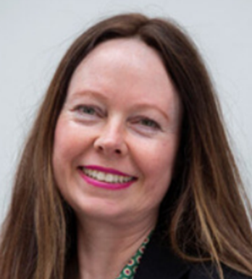
PROJECT LEAD
Heather Law
International Affairs Manager
Birmingham City Council
  Overseeing the city's 10 partner city relationships
  Managing several EU and domestically funded projects
  Bidding for Horizon Europe Projects
  Delivering You WIL – Young Women Into Leadership

Slide 3
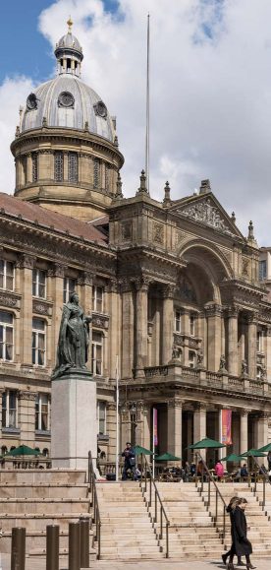
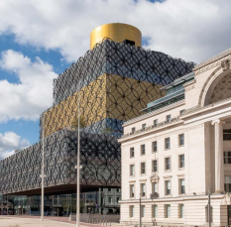
WHAT I WILL TALK ABOUT
European and International Affairs
Partner Cities
Project Lead
Involvement of Youth in International Activity
Birmingham Vision Missions
Young People in Birmingham
The Priorities for the City Council for 2025–28
What is You WIL?
Summit Organisation
Benefits of the Project
Previous Handbook
Contact Details

Slide 4
EUROPEAN AND INTERNATIONAL AFFAIRS
OUR ROLE
OUR ACTIVITIES
The European and International Affairs team leads for Birmingham City Council on
  European Funding
  Domestic Funding
  European Policy
  International Affairs
  Deliver Projects
  Partner Cities
  Networks
  Civic and Ceremonial
Greater Birmingham and West Midlands Brussels Office

Slide 5

EUROPEAN AND INTERNATIONAL AFFAIRS
This work is delivered through the European and International Strategy – Distinctly Birmingham, which sets out the city’s priorities for European and international engagement.
distinctlybirmingham.com

Slide 6
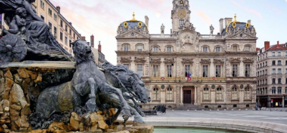

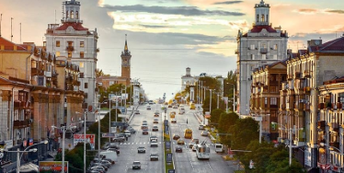

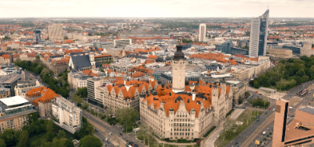
PARTNER CITIES
EUROPE
Lyon
1951
Frankfurt
1966
Zaporizhzhia
1966
Milan
1975
Leipzig
1992

Slide 7

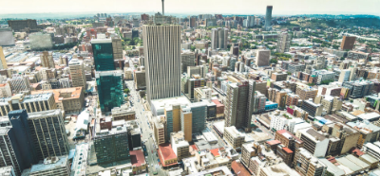


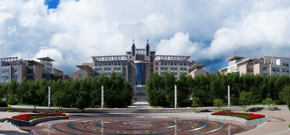
PARTNER CITIES
INTERNATIONAL
Chicago
1993
Johannesburg
1997
Guangzhou
2006
Nanjing
2006
Changchun
2013

Slide 8
INVOLVEMENT OF YOUTH IN INTERNATIONAL ACTIVITY
  Global House of Young Voices
  Frankfurt Birmingham 60 years partnership – City Pod with live linkup
  Europod
  Erasmus+
  School to school linkups
  Zaporizhzhia young people's programme 2026
  You WIL
Notes:
Key part of what we do internationally is to get young people involved in international opportunities. It is like the power of school trips – I remember first going to France for one day with my school at 12 and that first exposure to Europe made an incredible lasting impression including a desire to learn French and find out more about their culture and history.
Global House of Young Voices – Frankfurt initiative. We recruited from the The Birmingham Youth City Board, managed by the council's Youth Service, brings together young people aged 11–18 to ensure their voices influence city policy, covering topics like youth activism and safety. (The Board supports the UK Youth Parliament and works alongside the Young People's Independent Advisory Group. ). One person went to the event in Frankfurt to debate Youth issues and as a follow up, a group of young people went to our other German partner city, Leipzig to exchange with young people there.
This year celebrates 60 years of partnership with Frankfurt – we will host a mini shipping container in Victoria Square outside the council house with a live link up to Frankfurt. One day will include bringing young people together, it could be those who have engaged in You Wil in a curated discussion about education and opportunities in both countries.
Europod – sport, Lyon, Birmingham and Frankfurt young people involved in sporting activities
Erasmus plus, hosted young people from our partner cities in our office – eg support in organising the Frankfurt Christmas market. We're now back in Erasmus plus. (also Turing)
This year we are working with British Council and Bosnia House to bring over about 60 young people from Ukraine to Bham

Slide 9
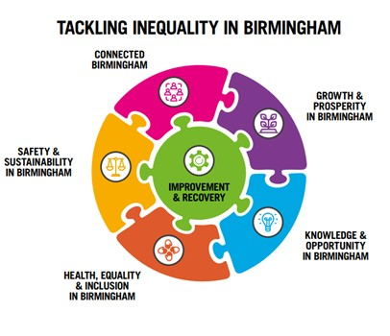
BIRMINGHAM VISION MISSIONS
  Birmingham’s Corporate Plan for 2025-2028.
  The shared vision for Birmingham is supported by five citywide Missions.​
  These Missions were developed in partnership to address the city’s biggest challenges and opportunities.​
  They provide a strategic framework for all partners to work toward shared goals.​
  The council’s specific responsibilities are reflected in the priorities set out in the Corporate Plan.

Slide 10
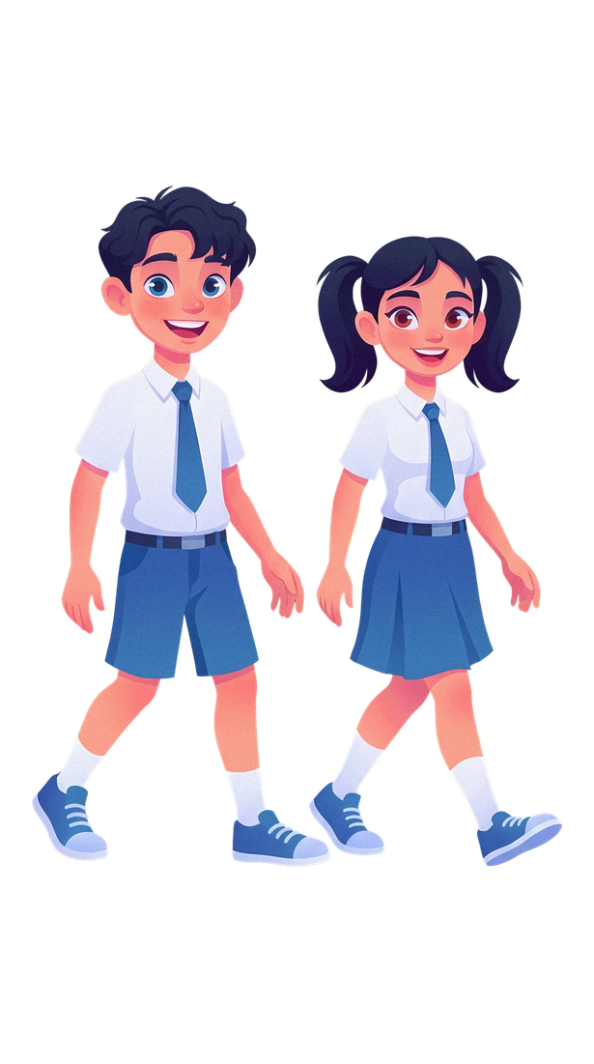

YOUNG PEOPLE IN BIRMINGHAM​
  Birmingham is a predominantly young city.
  59 out of Birmingham’s 69 wards have a higher proportion of school‑aged children than the England average of 13.5%: Bordesley Green (21.5%), Ward End (21.3%), and Heartlands (21.0%).
  We are a minority majority city​.
  Over 100 languages spoken​.
Male
51% - 93,047
Population in Birmingham
1,166,049
Aged over 65 years
12%
School-aged children
(5-15 years)
16% - 182,199
Aged under 35 years
51.4%
(National average of 42.6%)
Female
48% - 89,152
Source: Latest ONS population estimates for 2023

Slide 11
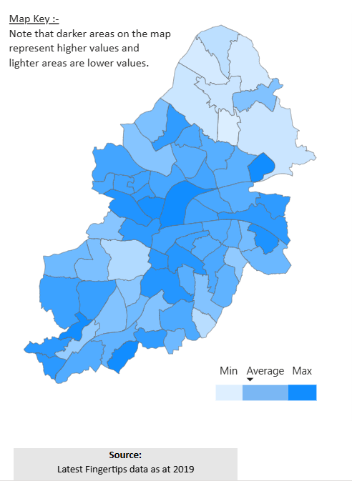
YOUNG PEOPLE IN BIRMINGHAM​
  In 2019, around 70,113 children aged 0–15 in Birmingham were living in income‑deprived families.
  This represents 27.6% of all children in the city.
  This rate was significantly higher than the England average of 17.1%.
  59 of Birmingham’s 69 wards had higher proportions of children living in income‑deprived families than the England average (17.1%).
  Nearly twice as many children in Birmingham are born into poor families compared with the England average.
  40% of children in Birmingham live in relative poverty - equivalent to 98,045 children.
Source: Latest ONS population estimates for 2023
Notes:
Many schools saying that their young people never leave their ward to go to the city centre.

Slide 12
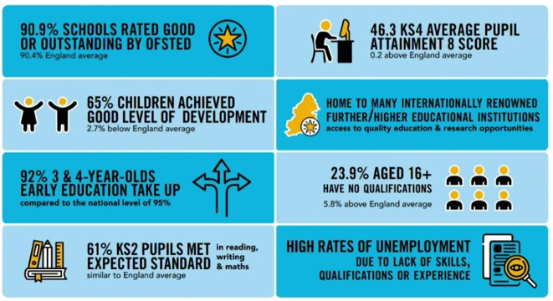
THE PRIORITIES FOR THE CITY COUNCIL FOR 2025-28​
PRIORITY 1: Investment and economic growth benefit all people and places in the city.​
PRIORITY 2: There is equal opportunity for people to get, and keep, good jobs.​
PRIORITY 3: Birmingham is promoted as a great place to live, visit and do business.​
PRIORITY 4: Businesses are supported to succeed; and illegal or unsafe business practices are addressed through effective regulation and enforcement.

Slide 13
WHAT IS YOU WIL?
Launch Date: July 2021 ​
Inspiration: Chicago - Global Youth Ambassadors Leadership Summit (GYALS). ​ Visit by the US Ambassador to Bham 2019.
Delivery Partners: Academic institution, Bham Education Partnership, Lord Mayor’s Office.
Ethos: Widening participation and a shared commitment to developing future women leaders.
How: On-line input from women leaders in varying themes. Women explain their career journey.
Partners: University of Birmingham, British Council, Birmingham Education colleagues and University of Illinois Urbana-Champaign (UIUC).​
Format: Online – 2-hour session per day with 2 additional mentor sessions – girls in multi-national teams to develop presentation on a successful female leader.​
Who: 14 – 16 year old girls from Bham and partner cities and other international connections
Funding: People's time
Timing: The next Summit from 20th July to 27th July.​
​
Notes:
- GYALS – in person event – city centre schools (incl Ormiston Academy) to travel to Chicago – week long event. Started 2016. Ambassador Johnson came to Birmingham to meet the girls who had participated and the then LM Cllr Yvonne Mosquito.
We intended for it to originally be an in person event and I managed to get funding from the US Embassy in London through the small grants programme. Covid. All went on line.
Who – Birmingham girls and girls from partner cities but also other countries – Mexico, Caribbean and India
Ethos – Aim to inspire participants to consider careers that may not traditionally be seen as careers for women. We invite women in a variety of careers to talk to the girls about their school/career journeys. Not to sugar coat any aspect including successes and failures and also myth busting. Eg. Students getting a 2.2 law degree can still become a solicitor. Each day is thematically focused and there is time for the girls to ask questions to the speakers via the chat function.

Slide 14
SUMMIT ORGANISATION: WEEK 1 ​
Online session run Monday to Monday after GSCE exams finish.​
​
Week 1 – Monday to Friday – 2 hours session per day & 2 mentor session​
Each day covers a different theme, in 2026:
  Leading for Change: Women in Politics, Public Service and Humanitarian Work​
  Future Founders: Women Leading in Business & Entrepreneurship ​
  The Power of Women in Sport and Wellbeing​
  Innovators of tomorrow: Women in Science, Technology, Engineering and Maths​
  Women Shaping the Arts, Culture, Media & the Creative Industries
​
Notes:
Women in Politics – local MPs, police constable
Women in Business – master butcher, Police constable, first black female president of Law Society
Women in sport – Olympian and broadcaster Denise Lewis, Jayne Torvil from Dancing on Ice
STEM – Scientist involved in identifying the remains of kind Richard 3rd in Leicester car park, Winner of the BCC Astronaughts have you got what it takes?
Women in arts – CEO of BRB, Comic strip the Beano artist, New presenter Nicola Beckford

Slide 15
SUMMIT ORGANISATION: WEEK 1 ​
Speakers
  Chancellor Sandie Okoro OBE – The first female Chancellor of the University of Birmingham, a pre-eminent lawyer and champion of equality rights, the inaugural Chair of the Women of the World (WOW) Foundation, Senior Vice-President and General Counsel at the World Bank Group.
  Prof Helen Pankhurst – Activist and Academic, CARE International, Centenary Action Group and great granddaughter of Emmeline Pankhurst leader of the British Suffragette movement.
  Simone Magill – Footballer for Birmingham City F.C. and Captain of the Northern Irish Women’s Football Team.
  Hannah England – Athletics World Championship medallist, Sports Broadcaster, co-founder of Birmingham Athletics Academy.
  Di Xiao – Concert pianist named amongst the 10 most outstanding Chinese concert pianists and champion of female composers.
Speakers recount their life/career journeys including successes and struggles.
Speakers are from all walks of life and reflect Birmingham's diverse communities
-Girls are encouraged to ask questions to the speakers via the online chat function and their microphones.
​
Notes:
Jayne Torvil Dancing on Ice, former Olympic skater
Dr Suzy Imber – BBC Astronauts Have you got what it takes
Local news presenters – Nicola Beckford BBC Midlands Today
Captain Preet Chandry – first woman of colour to solo expedition to S Pole

Slide 16
SUMMIT ORGANISATION: WEEK 1 ​
MENTORSHIP
Girls work in multi-national teams to develop a presentation on a woman leader who has inspired them.
Each team will be assigned a presentation theme from the 5 thematic areas explored during the week.
The ten minutes presentation on the last Monday will not involve all team members speaking but should provide some visual evidence of the individual contributions of team members on the first slide.
  Two mentor sessions with UoB staff, including a rehearsal on Friday in prep for the following Monday's presentation to a panel including reps from British Council, University of Illinois, UoB and BCC
​
Notes:
In addition to receiving a thematic speaker input, there are 2 additional mentor sessions for the girls to develop a presentation on a female leader who has inspired them.

Slide 17
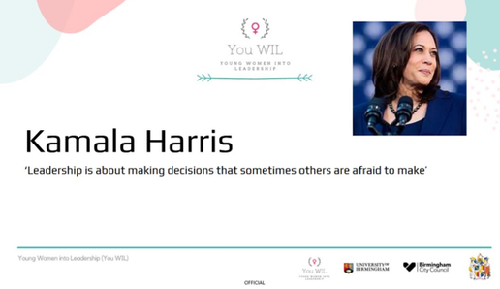

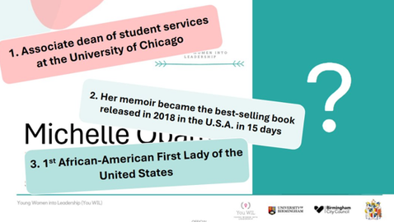

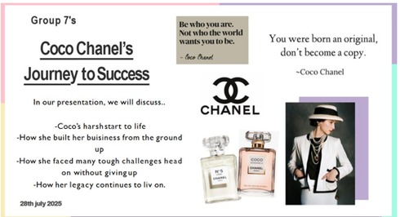

SUMMIT ORGANISATION: WEEK 2 - MONDAY
Week 2 – Monday ​
    The groups present their presentations live to a panel of female leaders including the British Council, University of Birmingham, University of Illinois for feedback.​
    Speakers are generous with their time, providing detailed responses in the chat function after students’ presentations and in follow up emails.​

Slide 18
BENEFITS OF THE PROJECT
  Develop leadership skills – build confidence, resilience, and independence.
  Practise transferable skills – improve public speaking, teamwork, and goal setting through mentorship and group presentation.
  Meet inspiring role models – connect with women leaders from a variety of backgrounds and hear their stories.
  Work in international teams – share ideas, learn from different cultures, and broaden your horizons.
  Make meaningful connections – build friendships and networks that last beyond the summit.
  Certificate - Each girl receives a certificate.

Slide 19
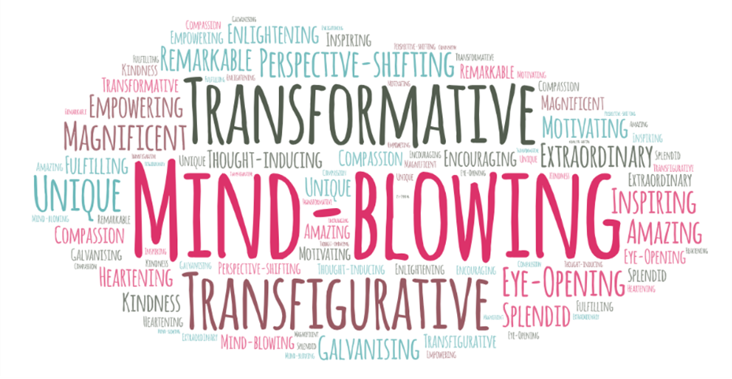
GIRLS' FEEDBACK
“It has given me more confidence into finding a field to go into, and I feel like it has opened up more career opportunities I may not have considered earlier such as the culture and media industry. I have also learnt skills of leadership and organising a team, as well as understanding and empathy when working in multicultural groups.” 2024
“The You WIL summit has helped me realize even ordinary people can become these inspirational leaders as long as I put myself out there. This has increased my confidence to make a name for myself by beginning from just finding where I can add value.” 2024
“The Summit has given me more clarity on what it would be like in each field of work, but it has also empowered me to follow my dreams so I can inspire young girls one day.” 2025
“During this week, several key messages from the speakers really stood out to me. First, the idea that every voice matters, regardless of age or background truly resonated. Sometimes I wondered if, as a young woman, I could actually make a difference, but hearing their stories showed me that even small actions can spark big changes.” 2025
Notes:
Some of the alumni from the programme went on to deliver their version of You WIL in school. One of the girls supported us in developing the handbook for last year's You WIL and also gave a presentation on their experience of You WIL to last year's cohort. Other girls have received further info on courses at the University of Birmingham and also received additional careers advice.

Slide 20
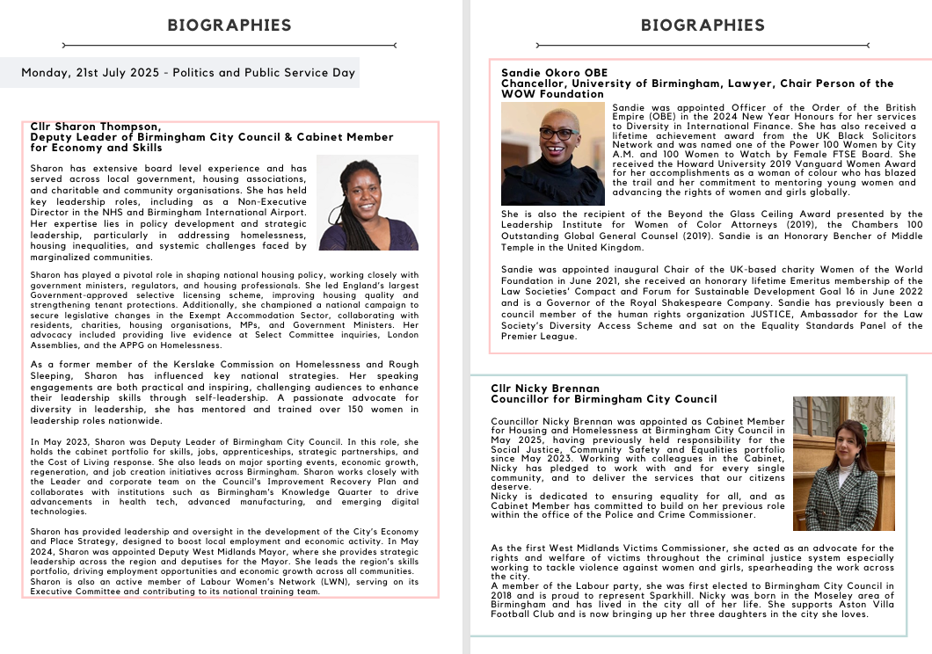

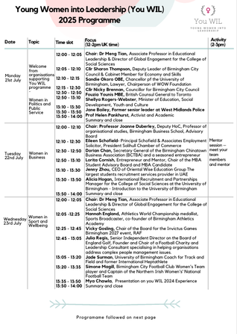
PREVIOUS HANDBOOK
2025 Summit Handbook​
2024 Summit Handbook​
2023 Summit Handbook​
2022 Summit Handbook
Notes:
All speakers and participants receive a handbook in advance of the summit. This includes speaker bios, information about participation etiquette, what is expected of them during the summit and contact details.

Slide 21

CONTACT DETAILS
Heather Law Heather.Law@birmingham.gov.uk
European and International Affairs Europe.Int@birmingham.gov.uk

